Slide 1
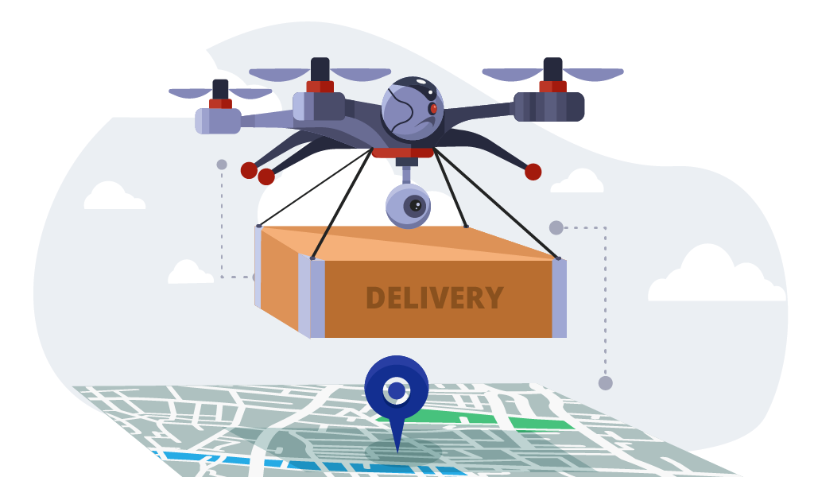
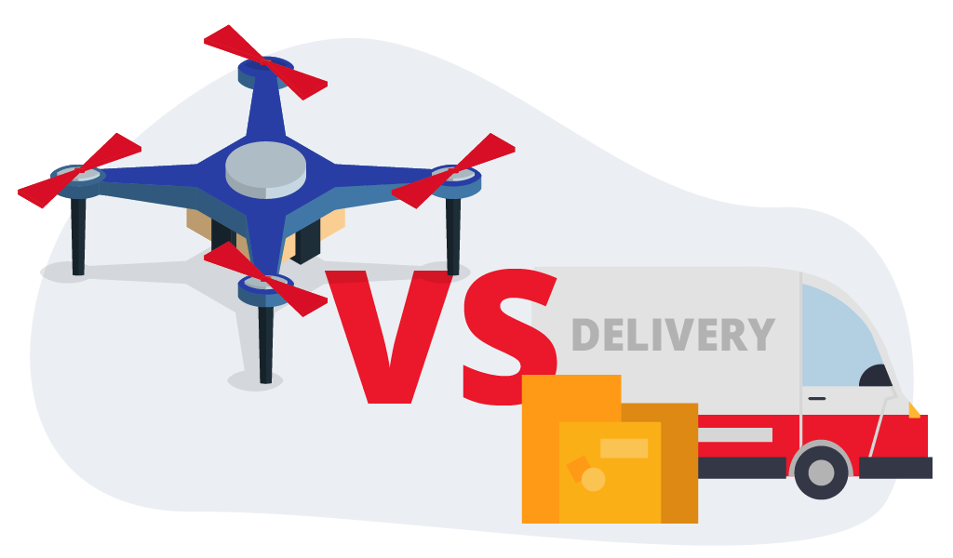
The Use of Drones for Delivery
Introduction
Having packages delivered by drones may seem like an idea from the future
However, it is actually already happening
If it grows into a more common tool, it could have many benefits
History
In 2013, Amazon announces Prime Air to deliver packages with drones
In 2021, Prime Air was at risk of failing
In 2022, after much trial-and-error, Prime Air takes flight
New Ideas or Technology
Upgrade the technology in drones we have currently
Increase the working range of drones
Increase the usage of drones for delivery
Benefits
Drones can access more remote areas easier than trucks
Using drones saves more money due to reduced labor costs
Drones can operate 24/7 while producing fewer emissions than typical delivery vehicles
References
Spector, Sean. “Drone Delivery: Everything You Need to Know in 2024.” Dropoff, 15 Nov. 2023, www.dropoff.com/blog/drones-delivery/.
Miriam McNabbMiriam McNabb is the Editor-in-Chief of DRONELIFE and CEO of JobForDrones. “Amazon Drone Delivery: A Brief History of the Patents, Problems and Progress from the DRONELIFE Archives.” DRONELIFE, 22 June 2022, dronelife.com/2022/06/20/amazon-drone-delivery-a-brief-history-of-the-patents-problems-and-progress-from-the-dronelife-archives/.

